Slide 1
Making this resource work for you
Prior to teaching this lesson, please refer to the ‘Unit Overview and Planning Document’.
Further guidance on planning Science Mastery lessons can be found in the detailed planning guidance document.
Refer to the ‘notes’ section on each slide for useful information, including suggested expositions, pedagogical content knowledge, suggested questions, answers and more. Consider using presenter mode so you can see this guidance throughout the lesson.
The introduction slides can be adapted to suit your teaching style and the needs of your class.
Before the lesson, adapt the fix-it slide to address any misconceptions identified in the previous lesson’s exit ticket.
Choose from the suggested activities to suit your class. The intention is not that you complete all of these, but that you select those which ones are most appropriate for your students. It may be appropriate to further adapt activities for your students.
These lessons are designed to occupy approximately 1 hour. To adapt for a shorter or longer lesson duration we advise you to adapt the activity section accordingly.
Please consider using the final slide to send feedback about this lesson or examples of PowerPoints that you have adapted to our design team. Your feedback is used to improve Science Mastery for all of our teachers and students. We appreciate all suggestions and comments.
Thank you for reading!
The Science Mastery Team

Slide 2
Microscopes
Answer the questions below.
State the function of a microscope.
Describe the key steps involved in the aseptic technique.
Explain why inoculated petri dishes are secured with tape but not the whole way round.
Describe how to calculate the total magnification of a microscope.
Name the part of the microscope where the slide is placed.
To magnify small objects that would otherwise not be visible to the naked eye.
The Petri dish is sterilised, the inoculating loop is sterilised, the agar lid is secured (but not completely sealed), the dish is incubated at 25 ºC.
Secured with tape to avoid contamination of the plate. Gaps are left to let oxygen in to keep the conditions aerobic.
Total magnification = eyepiece lens magnification x objective lens magnification
The stage
Notes:
Foundation: Name the part of the microscope that is first used to bring the specimen into view.
Stretch: Explain why scientists are worried about antibiotic resistance.
Answers:
Foundation: The coarse/rough focusing wheel.
Stretch: Antibiotic resistance is where bacteria are no longer affected/destroyed by antibiotics, meaning that there may be some diseases that have been previously treated by antibiotics that could not be treatable any longer.

Slide 3

B3.1.5
21/10/2024
Microscopes
B3.1.1 Prior Knowledge Review
B3.1.2 Eukaryotic and Prokaryotic Cells
B3.1.3 Aseptic Technique
B3.1.4 Growth of Bacteria
B3.1.5 Microscopes
B3.1.6 Observing Cells
B3.1.7 Diffusion
B3.1.8 Diffusion in Living Things
B3.1.9 Osmosis
B3.1.10 Osmosis Investigation
B3.1.11 Active Transport
B3.1.12 Cell Division
B3.1.13 Cancer
B3.1.14 Stem Cells
Notes:
Big Idea: Cells are alive
Previously pupils have learned the parts of a light microscope and their functions and how to view a sample under a microscope. In this lesson they will look at the theory behind microscopes, the differences between light and electron microscopes and how they have helped scientific understanding of cellular and subcellular structures. They will also learn how to calculate the actual size of an object based on the magnification and size of the image and practice this, before building on this skill and learning how to prepare a slide for viewing in the next lesson.
Suggested Hook:
A link in from the previous lesson- we previously looked at the growth of bacteria and mentioned (in the hook) how bacteria can be cultured and subsequently identified from patients. One way scientists can do this is by analyzing bacteria under the microscope. They not only look at the shape and structure of the bacteria but need to assess the size of the bacteria in order to make an accurate diagnosis but how can they work out the actual size of a bacteria under the microscope?

Slide 4

Following this lesson, students will be able to:
State the equation to calculate the magnification of an image
Describe the differences between light and electron microscopes in terms of their magnification and resolution
Explain how to identify the image size and the actual size of an object
Key Words:
electron
magnification
resolution
image
object
scale
sub-cellular

Slide 5
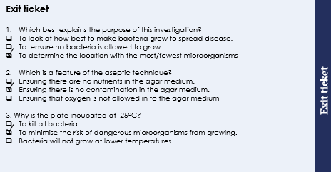
This is the fix-it portion of the lesson
The fix-it is an opportunity to respond to gaps in knowledge, especially those identified by the previous lesson’s exit ticket.
The teacher should customise this slide as needed, to facilitate
reteach, explanation, demonstration or modelling of ideas and concepts that students have not yet grasped or have misunderstood.
practise answering specific questions or of key skills.
redrafting or improving previous work.
Notes:
Purpose: to spend time on any gaps identified in previous learning from exit ticket feedback.
Answers:
Q1. Answer: C
If pupils answer A or B they have not identified the aim. To fix it give pupils independent and dependent variables and ask them to write an aim from it.
Q2. Answer: B
If pupils answer A or C they are unsure on the aseptic technique. To fix it practice writing method for aseptic technique.
Q3. Answer: B
If pupils answer A they have not appreciated the purpose of the practical. To fix it ask pupils to identify the purpose and then discuss why answer A is wrong. If pupils have answered C they have the misconception that cold temperatures totally stop bacterial/microorganism growth. To fix this ask pupils to explain why food inside a fridge can still go bad/go mouldy. Cold temperatures do not kill bacteria or prevent growth they just slow the growth

Slide 6
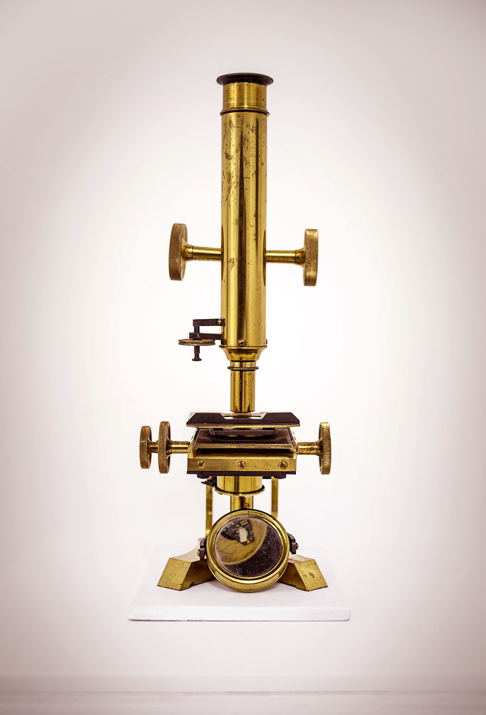
Microscopes
Microscope techniques have developed over time
Microscopes originated from a simple magnifying glass
In the 1590s a Dutch father and son called Hans and Zacharias Jansen experimented with different lenses and made the first compound microscope
The first real microscope was made and used by Anton van Leeuwenhoek in the 17th century – he was able to use the microscope to see very small objects, including microscopic animals and bacteria. His work was crucial to the development of cell theory.
Notes:
Exposition type: Explanation
Suggested Script:
Early microscopes were developed simply using lenses in the form of a magnifying glass, scientists worked out that using multiple lenses together gave a much greater magnification of the object (because you multiply the magnification of each lens together) and using this theory, In the 1590s the first example of a compound microscope (which contains more than one lens) was developed. Later on in the 1600s was when the first actual microscope was made. Anton van Leeuwenhoek used his microscope in the way that scientists do nowadays- to see things that cannot be seen with the naked eye. Being able to observe eukaryotic (animal/plant) and prokaryotic (bacteria) cells enabled science to progress very quickly and led to the development of cell theory. Watch the video on linked here for the history of cell theory that covers the last two points on this slide very well: Link: https://www.youtube.com/watch?v=4OpBylwH9DU
Key information - for this lesson, not explicit residual knowledge but interesting for background.
Light microscopes are limited in how much detail they can provide but can be used on live cells and tissues
Electron microscopes have greater magnification and resolution than light microscopes and have allowed scientists to study cells in greater detail, furthering understanding of sub-cellular structures, however the cell or tissue sample cannot be observed when living since the sample is placed in a vacuum.
Image source:
CC@https://commons.wikimedia.org/wiki/File:Microcinescope_Scientific_Sculpture_by_Interactive_Artist_Thomas_Marcusson.jpg

Slide 7
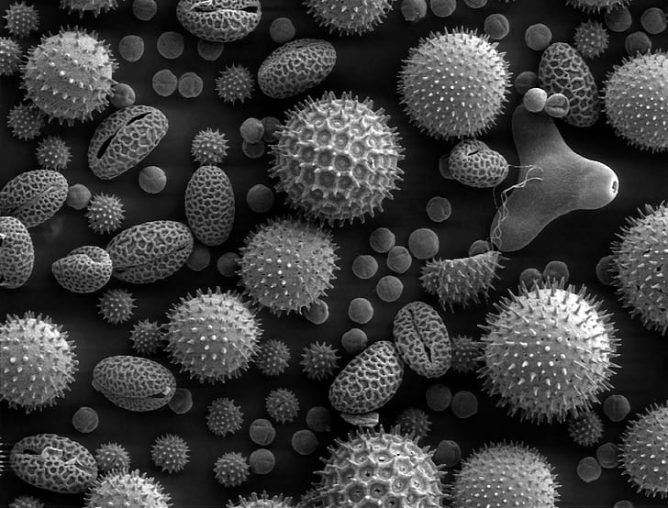
Microscopes
Light microscopes are limited in how much detail they can provide
Electron microscopes have greater magnification and resolution than light microscopes and have allowed scientists to study cells in greater detail, furthering understanding of sub-cellular structures.
Resolution is a measure of how detailed the image is.
Magnification can also be calculated by comparing the size of the image with the size of the real object
A stain is often used to make the organelles within a cell appear clearer
Notes:
Exposition type: Explanation
Suggested Script:
The kind of microscopes developed in the video and the kind we have seen and used previously all use light passing through lenses to magnify and object therefore we call them light microscopes. They are extremely useful and easy to transport however they are limited in the amount of detail they provide because the magnification is quite low. In the 1930s a different type of microscope was developed- the electron microscope. Electron microscopes do not use light but a beam of electrons to magnify a specimen, this overcomes the detail issue we find with light microscopes as electron microscopes have a much greater magnification and resolution which means you can observe objects in much greater detail.
If magnification is how much we can ‘zoom in’ then what is resolution? Resolution is the ability to distinguish between two points (e.g. how detailed/blurry the image is). So 1 nm resolution means that we can clearly see two objects apart that are 1nm in size. For example, a high resolution TV and a low resolution TV could both show the same magnification of something on TV, but the high resolution one allows you to see much more detail.
Electron microscopes have allowed scientists to observe cells in much greater detail which has led to a better understanding of cells and the different organelles found inside. Without electron microscopes, it would have been impossible to see what the inside of organelles and microorganisms look like.
Many organelles do not have a colour an so are difficult to see or distinguish under the microscope. Therefore stains are often used on specimens to make the organelles appear clearer. An example of a stain is iodine which can stain the cell walls and nuclei of plant cells (pupils will use this next lesson) or methyl blue which can be used to stain the nuclei of animal cells.
Key information - for this lesson, not explicit residual knowledge but interesting for background.
Light microscopes are limited in how much detail they can provide but can be used on live cells and tissues
Electron microscopes have greater magnification and resolution than light microscopes and have allowed scientists to study cells in greater detail, furthering understanding of sub-cellular structures, however the cell or tissue sample cannot be observed when living since the sample is placed in a vacuum.
Image source:
CC@https://www.pickpik.com/pollen-microscope-electron-microscope-scan-plants-grayscale-39441

Slide 8
Timeline
Electron microscopes allowed imaging of subcellular structures and viruses
20th century
Van Leeuwenhoek made the first light microscope and viewed microscopic animals and bacteria
1670s
Scientists discover cell structures such as the nucleus and mitochondria
19th century
1590s
First compound microscope
1838
Cell theory proposed
1931
German scientists Ruska and Knoll develop electron microscope
Notes:
This timeline can be used to review the developments in microscopes and cell theory.

Slide 9
Quick Quiz
Determine whether each statement is true or false:
Electron microscopes can provide a higher magnification than light microscopes.
The electron microscope was developed before the light microscope.
Much of the understanding of sub-cellular structures has come from the use of electron microscopes.
Total magnification of a light microscope can be calculated by adding together the eyepiece lens magnification and the objective lens magnification.
True
False
True
False
Notes:
Purpose: assess understanding of new information. Get students to hold up hands with thumbs up or thumbs down to choose answer. Take consensus with answers and use questioning to explain why these are the answers or correct the false statements.
Answers:
True
False
True – light microscopes could not provide this level of detail/focus.
False – total magnification is eyepiece x objective

Slide 10

Can you explain the difference between these two microscopes?
Light microscope
Electron microscope
Notes:
Partner talk to check understanding of differences between light and electron microscopes
Light – Uses light. Lower magnification and resolution
Electron – Uses beam of electrons. Higher magnification and resolution
Take feedback to address any misconceptions before moving on
Suggested guidance:
Talk tasks can be used in a variety of ways to suit the particular needs of the students you are teaching. Through exchanging views with others, students develop their understanding of the science beyond what could be achieved individually.
Science classrooms that successfully integrate talk have the following features:
Science talk is a regular feature of lessons and is woven into classroom activities.
Students are paired or grouped strategically by the teacher to ensure productive interaction. This might take into consideration the students’ proficiency of the English language, how encouraging they might be to peers and their attainment in the topic. It’s a good idea to consider these pairings in the class seating plan.
Students are encouraged and supported to talk, but are not forced to talk.
The teacher should take on the role of a facilitator, engaging with conversations where necessary and encouraging or steering the conversation where needed.
Students are encouraged to use the language they have to express their ideas (e.g., everyday language, imperfect English, native language), but also to incorporate science specific terminology where this is more accurate or has been taught.
6. Scientifically inaccurate ideas are not dismissed by the partner or teacher; open discussion and further investigation are relied on to help students construct ideas that support them to progress in their scientific understanding.
7. Guidelines for behaviour during talk tasks are explicit and frequently reviewed. Rules for students might be:
Listen carefully to your partner
Take turns talking.
Speak one at a time, without interrupting.
Politely agree or disagree and explain why.
Politely point out if your partner has used a scientific word incorrectly, if they have explained the science incorrectly, or if there is a more accurate way to describe something.
If confused, ask questions.
Stay focused on the discussion topic.
Respond to one another.

Slide 11
Can you explain the difference between these two terms?
Magnification
Resolution
Notes:
Partner talk again – it is really important that they don’t use these terms interchangeably and that they are able to define each separately
Magnification – making an object appear larger than it actually is
Resolution – the ability to distinguish between two points (e.g. how detailed/blurry the image is)
Suggested guidance:
Talk tasks can be used in a variety of ways to suit the particular needs of the students you are teaching. Through exchanging views with others, students develop their understanding of the science beyond what could be achieved individually.
Science classrooms that successfully integrate talk have the following features:
Science talk is a regular feature of lessons and is woven into classroom activities.
Students are paired or grouped strategically by the teacher to ensure productive interaction. This might take into consideration the students’ proficiency of the English language, how encouraging they might be to peers and their attainment in the topic. It’s a good idea to consider these pairings in the class seating plan.
Students are encouraged and supported to talk, but are not forced to talk.
The teacher should take on the role of a facilitator, engaging with conversations where necessary and encouraging or steering the conversation where needed.
Students are encouraged to use the language they have to express their ideas (e.g., everyday language, imperfect English, native language), but also to incorporate science specific terminology where this is more accurate or has been taught.
6. Scientifically inaccurate ideas are not dismissed by the partner or teacher; open discussion and further investigation are relied on to help students construct ideas that support them to progress in their scientific understanding.
7. Guidelines for behaviour during talk tasks are explicit and frequently reviewed. Rules for students might be:
Listen carefully to your partner
Take turns talking.
Speak one at a time, without interrupting.
Politely agree or disagree and explain why.
Politely point out if your partner has used a scientific word incorrectly, if they have explained the science incorrectly, or if there is a more accurate way to describe something.
If confused, ask questions.
Stay focused on the discussion topic.
Respond to one another.

Slide 12
Drill
State the equation used to calculate magnification
How are cells made to appear clearer when using a microscope?
Name the type of microscope which has a high resolution and high magnification (light or electron microscope).
State and explain which type of microscope is more convenient to use in a school laboratory.
State one disadvantage of using electron microscopes.
Convert 1mm to µm
Notes:
Purpose: This is a knowledge drill. The purpose of this is to check that the critical knowledge is secure before pupils move onto independent practice.
Suggested guidance: There are a range of ways this could be done depending on time and ability range of the class:
Mini whiteboards
As full sentences in exercise books
As short answers in exercise books
In the pupil workbook
As pair talk
As cold call

Slide 13
Drill answers
Magnification = Size of Image
Size of object
Applying a stain
Electron microscope
Light microscope, as it is smaller and less expensive.
The sample cannot be live/must be dead, the microscope is large and expensive, more difficult to use, they typically produce black and white images
1000µm
Notes:
Purpose: This is a knowledge drill. The purpose of this is to check that the critical knowledge is secure before pupils move onto independent practice.
Suggested guidance: There are a range of ways this could be done depending on time and ability range of the class:
Mini whiteboards
As full sentences in exercise books
As short answers in exercise books
In the pupil workbook
As pair talk
As cold call

Slide 14
Orders of magnitude
Prefix | Conversion to SI units (m)
milli (mm) | x10⁻³
micro (µm) | x10⁻⁶
nano (nm) | x10⁻⁹
X 1000
÷ 1000
X 1000
÷ 1000
Notes:
Purpose: To remind pupils of the prefixes milli, micro and nano

Slide 15
Orders of magnitude
Nanometre (nm) | Micrometre (µm) | Millimetre (mm)
5 | 0.005 | 0.000005
1
 | 1
 |  | 1
 | 3
7
 |  | 0.5
0.001
0.000001
1000
0.001
1 000 000
1000
3000
0.003
0.007
0.000007
500 000
500
Notes:
Purpose: assess understanding of new information. Get students to fill in the table with the missing values.

Slide 16
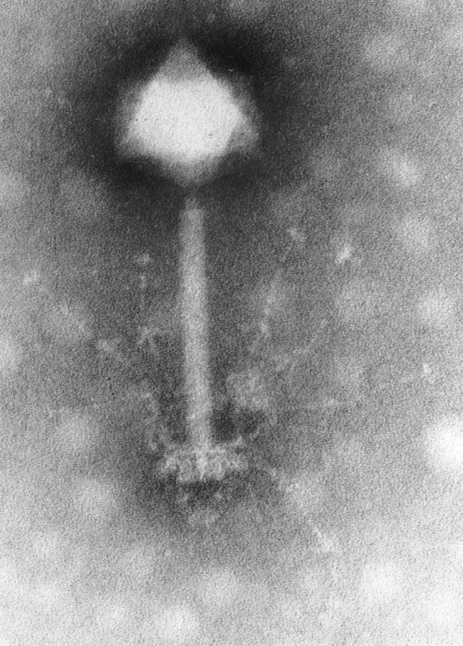
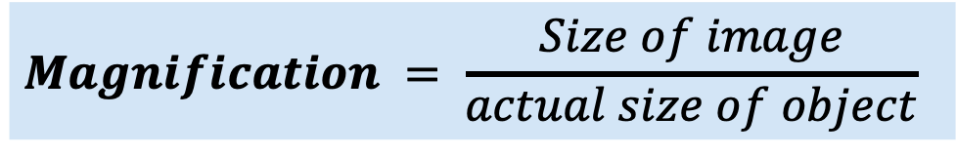
Calculating magnification
The image on the right shows an electron micrograph image of a bacteriophage.
The length of the scale bar is 1 cm (10 mm).
We can calculate the magnification used for this image using the formula:
= 10 mm
0.0001 mm (nm converted to mm)
= 100000
(This object has been magnified 100000 times)
$$Magnification = \frac{Size of image}{actual size of object}$$
100 nm
Notes:
Exposition type: Modelling
Suggested script: We need to use the information in the question to calculate the magnification. We know that magnification is equal to the size of the image divided by the actual size of the object. The size of my image is 10mm so I substitute that into my formula. The size of my object is 100 nm. To be successful in these equations I need to ensure I am using values with the same units. Therefore I need to convert the size of my object from nm to mm. To do that I divide 100 by 1000 to give 0.1 um and then divide by 1000 again to give 0.0001 mm. My units are now the same so I can substitute 0.0001 mm into my formula. When I divide, my answer is 100,000 meaning that my object has been magnified 100,000 times or that the image appears 100,000 times bigger than the actual object. As magnification is a ratio I do not need to include any units in this answer.
Misconception – often students find it strange to write an answer to a calculation without units. It is useful to stress that there are no units for magnification because it is just a ratio of how many times the object has been magnified.

Slide 17
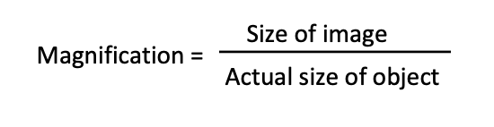
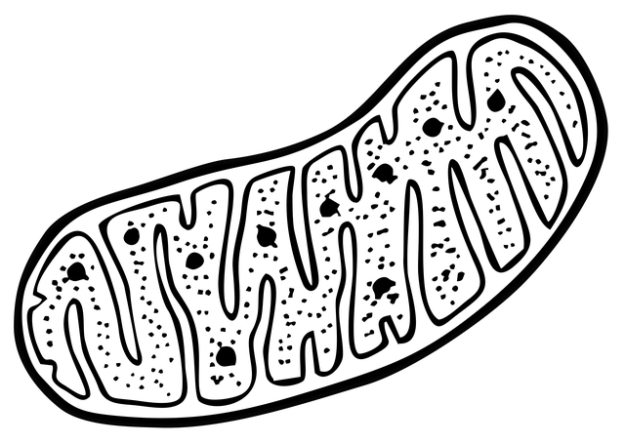
Calculating magnification
The image on the right shows an electron
micrograph image of a mitochondria.
The measured length of bar AB in the image is 21 mm.
The actual length is 1.5 µm.
Calculate the magnification for this image
Magnification = Size of Image
Size of object
= 21 mm
0.0015 mm (µm converted to mm)
= 14000
A
B
Notes:
Purpose: assess understanding of new information. Get students to complete the magnification calculation.
Misconception – often students find it strange to write an answer to a calculation without units. It is useful to stress that there are no units for magnification because it is just a ratio of how many times the object has been magnified.
This image is from pixabay and is not an actual micrograph image.

Slide 18
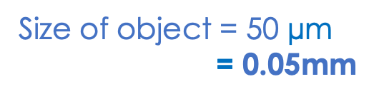
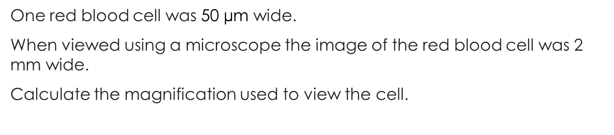
I: Worked example
V
E
S
C
U
One red blood cell was 50 $\text{µ}$m wide.
When viewed using a microscope the image of the red blood cell was 2 mm wide.
Calculate the magnification used to view the cell.
Magnification = ?
Size of image = 2mm
Size of object = 50 $\text{µ}$m
= 0.05mm
Magnification = Size of Image
Size of object
Magnification = 2 h
0.05
Magnification = X40

Slide 19
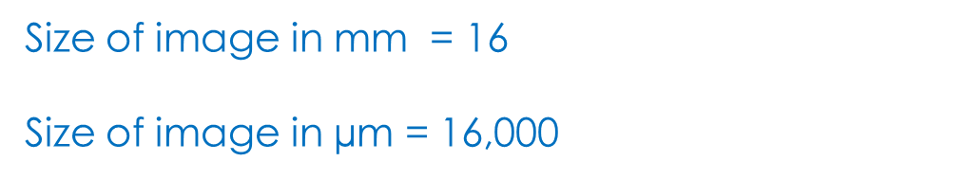
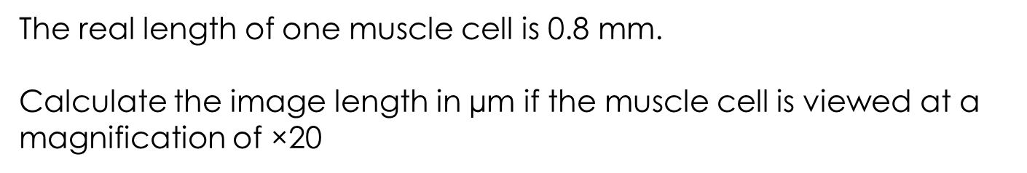
We: Worked example
V
E
S
C
U
The real length of one muscle cell is 0.8 mm.
Calculate the image length in $\text{µ}$m if the muscle cell is viewed at a magnification of ×20
Magnification = X 20
Size of image = ?
Size of object = 0.8 mm
20 = Size of Image
0.8
Size of image in mm = 16
Size of image in $\text{µ}$m = 16,000

Slide 20
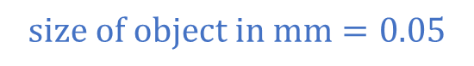
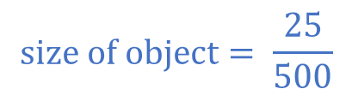
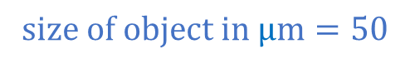
You: Worked example
V
E
S
C
U
A student viewed a section of a leaf using a microscope.
The student measured the length of one of the palisade cells.
The cell image measured 25 mm in length when viewed at a magnification of ×500
Calculate the size of the palisade cell in millimetres (mm).
Magnification = x500
Size of image = 25mm
Size of object = ?
Magnification = Size of Image
Size of object
500 = 25 h
Size of object
$$size of object= \frac{25}{500}$$
$$size of object in mm=0.05$$
$$size of object in \text{µ}m=50$$

Slide 21
Microscopes
Complete the worksheet
You will need a ruler to measure the sizes of images
The table on the right may help you with conversions
Prefix | Conversion to SI units (m)
milli (mm) | x10⁻³
micro (µm) | x10⁻⁶
nano (nm) | x10⁻⁹
Notes:
Purpose: practise using new key information for this lesson. Self or peer assess using mark scheme (will need to be edited by teacher depending on the paper size for printing and completed for values that have to be measured – Q4b,c & Q5)
Some pupil may have covered standard form in maths, others may not as it is only covered usually later in Y9/Y10. It is also possible to get them to go between using divide/multiply by 1000. Otherwise they can simply make sure that the image size and object size are in the same units.
Stretch activity suggestions – peer support. Get pupils that are mathematically strong to help pupils that are struggling with the calculations. You may also want them to write a method to help them remember how to perform the calculations.
The biggest misconception here is that pupils will confuse the image size and the size of the actual object. It may help to remind them that because we are using a microscope the actual object will always be smaller than the image. This means that for calculations it will always be a larger numerator than denominator and the resulting magnification will always be greater than 1. If pupils remember this rule then it becomes easier for them to realise when they have substituted incorrectly.

Slide 22
Answer the questions below.
Which statement is correct?
A. Both light microscopes and electron microscopes allow us to look at large objects that are far away on a much smaller scale.
B. Light microscopes have the greatest magnification and allow us to look at sub-cellular structures
C. Electron microscopes have greater magnification than light microscopes and have enhanced understanding of sub-cellular structures.
✓
Notes:
Purpose: to find out if students are able to answer key questions that check for understanding of the new information/skills that have been covered.
Suggested guidance:
Give students thinking time and then ask for feedback – either holding up fingers for the right number/letter, using mini whiteboards or just writing answers down in books quickly before cold calling.
Answers
Q1. Answer: C If pupils answer A they have the misconception of why microscopes are used- they are thinking of a telescope. If pupils answer B they may have been distracted by the information about sub-cellular structures. To fix it recap the differences between the types of microscope and when each would be used. Emphasise that both types of microscope allow scientists to view sub-cellular structures but electron microscopes have the higher magnification/resolution

Slide 23
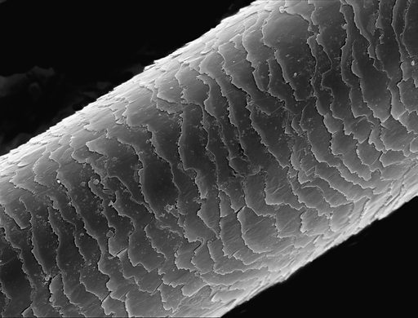
Answer the questions below.
2. The image on the right shows a strand of human hair. The red line measures 20 mm and the width of the hair is 0.001 mm. Which statement is correct?
A. Image size is 20 mm, actual size of object is 0.001 mm.
B. Image size is 0.001 mm, actual size of object is 20 mm.
C. You need to know the magnification to calculate the image size and actual size
✓
3. What is the magnification of this image using the given information in question 2?
A. 0.02
B. 20000
C. 0.00005
✓
Notes:
Answers:
Q2. Answer: A
Q3. Answer: B
If pupils have answered either A or C they have substituted incorrectly into the magnification equation. If pupils answered B to Q2 they will have got answer C to Q3. To fix it (Q2 and 3) practice a further magnification where pupils have to identify which is the actual size of the object and which is the size of the image and subsequently calculate the magnification.
Image source:
CC@https://www.lookandlearn.com/history-images/YW008759B/Human-hair-Asian-origin

Slide 24
Lesson B3.1.5
What was good about this lesson? | What can we do to improve this lesson?
Send us your feedback by clicking this link
or by emailing sciencemastery@arkonline.org
Thank you!

